Slide 1
Learning from Data, Making More of It, and the Road to the MLP
AA-5750 Contemporary Issues in Analytics · Week 1 · Chandra Prakash Bathula
Notes:
Week 1 framing: today connects three ideas. What it means to learn from data, how we stretch a small dataset with augmentation, and how 43 years of neural network history (1943 to 1986) led to the MLP we train in this week's assignment.

Slide 2




Today's journey
01
02
03
04
Learning from data
Data augmentation
The perceptron story
Finally, just an MLP
What a model really learns, and why the test set is the only score that matters.
Making new training examples from old ones, for images and for text, without breaking labels.
Neurons, the perceptron vs logistic regression, the AI winters, and the comeback.
Stack perceptrons, add a non-linearity, train with backprop: the model in this week's assignment.
Notes:
These slides complement the earlier Week 1 slides on ML types, activation functions and the backprop numerical example. Nothing here repeats them; the focus is generalization, augmentation and the history of the perceptron.

Slide 3
Learning from data
PART 1
A different lens on machine learning: functions, losses and generalization
Notes:
We already saw the types of ML. Here we look at what every learning algorithm has in common.

Slide 4



Machine learning in one line: find f so that f(x) ≈ y
Model
f(x) ≈ y
A family of candidate functions: lines, trees, neural networks. Choosing the family decides what f can express.
Loss
x an input: pixels, words, a customer record
y the answer we want: a digit, a sentiment, a price
f the function we learn from examples
A single number that measures how wrong f is on the training data, such as cross-entropy for classification.
Optimizer
A procedure that nudges f's parameters to lower the loss, such as gradient descent or Adam.
Notes:
Every model in this course, from an MLP to a Transformer, is these three pieces. Only the model family changes as the course progresses.

Slide 5


The goal is not the training set, it's the next example
The memorizer
The learner
Scores near 100% on training data
Learns quirks, noise and coincidences
Falls apart on new examples
Like a student who memorizes past exam answers
Scores a little lower on training data
Learns patterns that repeat across examples
Holds up on data it has never seen
Like a student who understands the method
Generalization gap = training accuracy − test accuracy. A large gap means the model is memorizing.
Notes:
The test set is a stand-in for the future. In the assignment, every plot you make is really a plot of this gap.

Slide 6
Our MNIST MLP has far more knobs than examples
109,386
5,000
≈ 22
trainable parameters
training images
parameters per example
in the 784 → 128 → 64 → 10 MLP
in the baseline notebook
plenty of room to memorize
When a model has this much capacity, it can fit almost anything, including noise. There are two cures, and this week's assignment tests both:
More real data: scale MNIST from 5k to 50k images.
More varied data: augment CIFAR-10 so every epoch sees new versions of each image.
Notes:
Parameter count: fc1 784x128+128 = 100,480; fc2 128x64+64 = 8,256; fc3 64x10+10 = 650. Total 109,386. Divided by 5,000 images gives about 22 parameters per training example.

Slide 7



Labelled data is the bottleneck
Expensive
Slow
Imbalanced
Every label needs a person. Medical, legal and financial labels need specialists whose time is scarce.
ImageNet's ~14 million labelled images took several years of crowdsourced work to build.
Rare classes such as fraud or rare diseases have few examples by definition, exactly where we need them most.
If we can't collect more data, can we create more from the data we already have?
Notes:
This question is the bridge to Part 2. The answer is yes, as long as the new examples keep the right label.

Slide 8
Data augmentation
PART 2
Same label, new example
Notes:
Augmentation is one of the cheapest and most reliable ways to improve generalization. The key is knowing which transformations are safe.

Slide 9




Augmentation: transform the input, keep the label
Original · label: iris
Flipped · label: iris
Rotated 20° · label: iris
Colour jitter · label: iris
(x, y) → (T(x), y)
Each transformation T is a claim: "this change does not affect the label." Applied randomly every epoch, it shows the model many plausible versions of every training example.
Notes:
These are real outputs from iris.jpeg in the Image Augmentation notebook. A human still says iris for every one of them, so the label is preserved.

Slide 10



Image toolbox: what each transform teaches
Horizontal flip
Rotation
Random crop
Colour jitter
Noise
Random erasing
Left vs right doesn't matter
Tilted camera or page
Object position and scale vary
Lighting and camera differences
Sensor noise in low light
Occlusion: use more than one cue
Standard CIFAR-10 recipe: RandomCrop(32, padding=4) + RandomHorizontalFlip(), applied to training images only.
Notes:
Each transform encodes one invariance. Pick the ones that match what changes in the real world for your data. The interactive pipeline in the Week 1 web guide lets students adjust each of these live.

Slide 11
Text toolbox: four cheap edits and one expensive one
Original: "The plot was boring and the acting was terrible." (negative)
Technique | Augmented sentence | Label risk
Synonym replacement | The storyline was dull and the acting was terrible. | Low
Random insertion | The plot was boring tedious and the acting was terrible. | Low
Random swap | The acting was boring and the plot was terrible. | Medium: meaning can shift
Random deletion | The plot was boring and the acting terrible. | Medium: may drop "not"
Back-translation (EN → FR → EN) | The storyline was dull and the performance was awful. | Low, but needs a translation model
The first four are the EDA operations (Wei & Zou, 2019). Back-translation sentence shown is illustrative.
Notes:
EDA uses one knob, alpha, the share of words changed (around 0.05 to 0.1). Back-translation gives the most natural paraphrases because translation models are trained to preserve meaning.

Slide 12


The golden rule: would a human give it the same label?
Safe: label preserved
Unsafe: label changes
Flipping a photo of a cat or a car
Rotating a handwritten digit by 10°
"boring" → "dull" in a review
Brightness changes on street scenes
Rotating a "6" by 180°: it becomes a "9"
Flipping a "b": it becomes a "d"
Deleting "not" from "not good"
Embedding swap "good" → "bad" (close vectors, opposite meaning)
Big hue shifts when colour defines the class (ripe vs unripe fruit)
Notes:
A transformation that is safe for one dataset can corrupt another. Horizontal flips are standard for CIFAR-10 and wrong for MNIST.

Slide 13
Where augmentation lives in the pipeline
Train: augment on the fly
Train the model
Raw data
Split train / test
Test: fixed preprocessing only
Evaluate honestly
1
Split first
2
Train only
3
On the fly
Augmented copies of a test example must never leak into training.
The test set measures real data, so it is never augmented.
A new random version every epoch, nothing saved to disk.
Notes:
In PyTorch this means two transform pipelines: train_tf with random transforms and test_tf with only ToTensor and Normalize.

Slide 14



Why augmentation works
More effective data
Encodes invariance
Acts as a regularizer
Every epoch sees new variants, so 5k images act like a larger dataset. The copies are correlated, so they are worth less than new real images.
It tells the model what should not matter. An MLP has no built-in sense of shifts or flips, so it has to learn them from examples.
Training accuracy drops, test accuracy holds or rises, and the generalization gap shrinks. Judge it on the test set.
Evidence (Wei & Zou, 2019): simple text augmentation added about 3 points of accuracy with 500 training sentences, and under 1 point on full datasets. It helps most when data is scarce.
Notes:
Theory: augmentation is a form of vicinal risk minimization (Chapelle et al., 2000), and training with small input noise approximates Tikhonov regularization (Bishop, 1995). The web guide has an interactive demo.

Slide 15
Deep learning begins
PART 3
From the biological neuron to the perceptron, the AI winters, and the road to 2012
Notes:
The earlier slides covered how a perceptron computes. This part covers where it came from, what it could and could not do, and why the field nearly abandoned it.

Slide 16
Four decades from an idea to a working network
1943
1958
1969
1974
1986
McCulloch & Pitts
Rosenblatt
Minsky & Papert
Werbos
Rumelhart, Hinton & Williams
Neurons as logic gates
The perceptron learns its own weights
"Perceptrons" proves single-layer limits
Backprop in a PhD thesis, largely unnoticed
Backprop trains hidden layers
1949
1960
1970s
1982
Hebb
Widrow & Hoff
AI winter
Hopfield
Learning by strengthening connections
ADALINE and the LMS rule
Funding and interest collapse
Networks as energy systems
Rise
Fall
Revival
Notes:
Read the colours as a story: a rise from 1943 to 1960, a fall after 1969, and a revival that started quietly in 1974 and became mainstream in 1986.

Slide 17


1943 to 1949: neurons as logic, learning as wiring
1943 · McCulloch & Pitts
1949 · Donald Hebb
A logical neuron
The Organization of Behavior
Binary threshold units: fire if enough inputs are on
Showed that networks of them can compute logic such as AND, OR and NOT
No learning: a human had to set every weight
Connections between neurons that are repeatedly active together grow stronger
The first concrete rule for how a network could learn from experience
Still the intuition behind "weights store what was learned"
Notes:
McCulloch and Pitts gave us the unit; Hebb gave us the idea of learning by adjusting connections. Rosenblatt combined the two in 1957 to 1958.

Slide 18
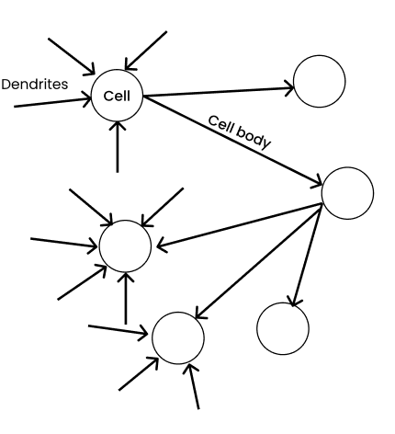
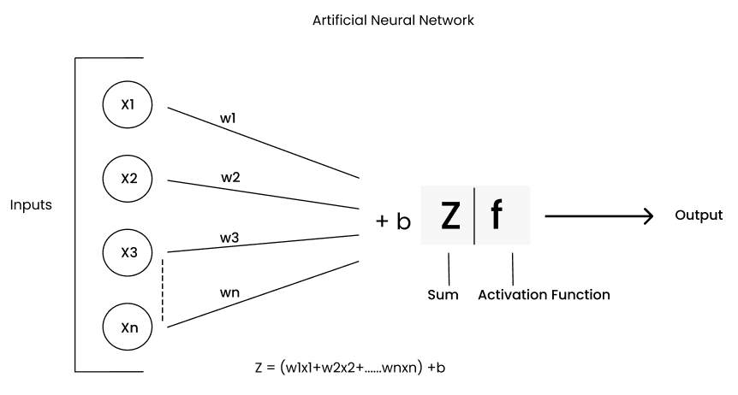
From a biological neuron to an artificial one
Figures: Chandra Prakash Bathula, Deep Learning series, Part 2 (Towards AI)
Dendrites
Connection strength
Cell body
Fires or not
→ inputs xᵢ
→ weights wᵢ
→ z = Σ wᵢxᵢ + b
→ activation f(z)
Notes:
From Part 2 of the Deep Learning blog series. Thicker dendrites in the sketch stand for stronger connections, which become larger weights. The output O = f(sum of w_i x_i + b) can feed many neurons in the next layer. Roughly inspired by biology, not a copy of it.

Slide 19
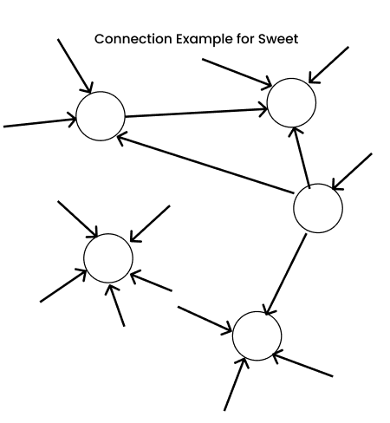
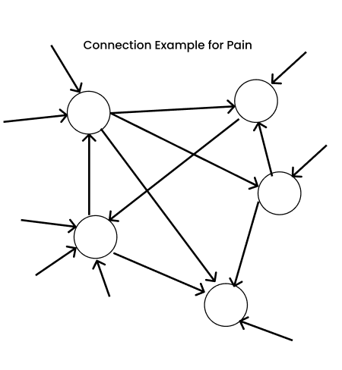
Learning lives in weighted connections
At birth: relatively few connections in the cerebral cortex.
By about age six: years of sensory, language, vision and hearing experience have multiplied them.
Teenage years: unused connections are pruned, because every connection costs energy.
Every experience: builds its own pathway, with its own weights.
Tasting something sweet
Touching something hot
Figures: Chandra Prakash Bathula, Deep Learning series, Part 2 (Towards AI)
Biological learning = weighted connections. Artificial learning is the same idea in numbers: training adjusts weights so the right inputs light up the right paths.
Notes:
The sweet and pain diagrams show two experiences building two different weighted pathways. Ask students to keep this picture for the MLP: a 3 and a 7 activate different weighted paths through the hidden layers.

Slide 20
1958: the perceptron learns its own weights
The learning rule
400
ŷ = step(w · x + b)
w ← w + η (y − ŷ) x
photocells in a 20 × 20 grid formed the Mark I Perceptron's "retina"
Correct prediction: y − ŷ = 0, so nothing changes.
Wrong prediction: the weights move toward the misclassified example.
Convergence theorem (Novikoff, 1962): if a straight line can separate the classes, this rule is guaranteed to find one in a finite number of updates.
Conceived by Rosenblatt in 1957 at the Cornell Aeronautical Laboratory, shown publicly in 1958 with US Navy funding. Weights were motor-driven potentiometers.
Notes:
This is the big change from 1943: the machine sets its own weights from labelled examples. The convergence guarantee holds only when the data is linearly separable, which is exactly where the trouble starts.

Slide 21
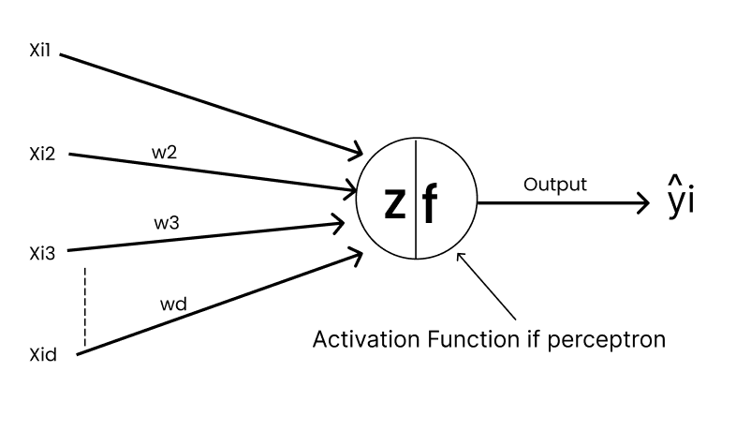
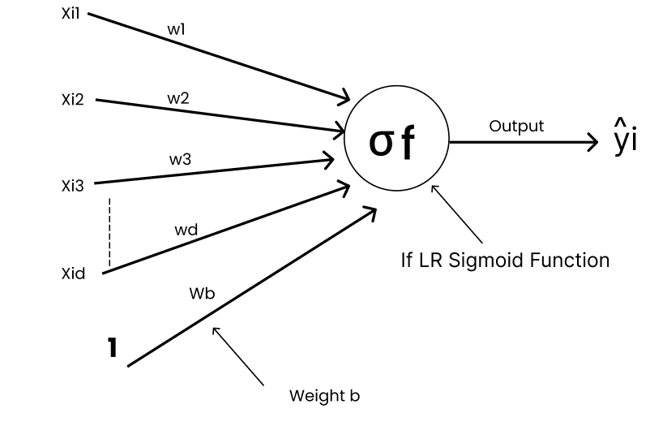
Perceptron vs logistic regression: same z, different last step
Perceptron
a switch: 0 or 1
Logistic regression
a dimmer: probability
 | Perceptron (1957) | Logistic regression
Score | z = W·X + b | z = W·X + b (identical)
Output | step(z): 1 if z ≥ 0, else 0 | σ(z) = 1 / (1 + e⁻ᶻ), between 0 and 1
Update | w ← w + η (y − step(z)) x, only when wrong | w ← w + η (y − σ(z)) x, every example
Converges | Only if the classes are linearly separable | Convex loss: settles even when classes overlap
Figures: Chandra Prakash Bathula, Deep Learning series, Part 3 (Towards AI)
Notes:
From Part 3 of the blog series. Both models compute the same weighted sum; only the activation differs. The update rules differ only in step(z) vs sigma(z): replace the hard switch with a smooth dimmer and the error becomes a continuous signal gradient descent can use. Generalized through layers with the chain rule, that is backpropagation. The web guide page 07 lets students train both live.

Slide 22

The hype arrived before the results
“the embryo of an electronic computer that [the Navy] expects will be able to walk, talk, see, write, reproduce itself and be conscious of its existence.”
The New York Times, July 8, 1958, reporting on the perceptron demonstration
Then
A contemporary issue
A single trainable layer that separated simple shapes was presented as the start of machine consciousness.
Compare today's claims about AI. When promises outrun capability, the backlash can stall a whole field.
Notes:
Good discussion prompt: which current AI claims look like the 1958 headline, and what evidence would separate real capability from hype?

Slide 23




Where the perceptron worked
Simple pattern recognition
ADALINE (Widrow & Hoff, 1960)
Learned to tell apart simple shapes and letters on its photocell grid, whenever a straight line could separate the classes.
Trained with the least-mean-squares (delta) rule, which follows the gradient of a squared error. A direct ancestor of gradient descent in neural networks.
First real-world deployment
A mathematical guarantee
MADALINE, a network of ADALINE units, was used to cancel echoes on telephone lines. Adaptive filters descended from this work are still in use.
The convergence theorem gave learning machines a proof, not only demonstrations: separable data is always learned.
Notes:
The common thread: everything that worked was linearly separable or linear by design. ADALINE matters because it used a continuous error signal, which is the idea backprop later generalizes.

Slide 24
Where it failed
XOR and parity
XOR: no single line works
No single straight line separates the classes, so a single-layer perceptron cannot learn them at all.
Connectedness
(0,1)
(1,1)
Minsky & Papert proved that perceptrons whose units each see only a small patch cannot tell whether a shape is connected.
Hidden layers could not be trained
The credit assignment problem: when the output is wrong, which hidden unit is to blame? There was no rule for that.
(0,0)
(1,0)
No gradient to follow
● output 1 ○ output 0
The step function is flat almost everywhere, so calculus gives no direction for improvement.
Notes:
The first two are limits of representation; the last two are limits of training. Multi-layer networks could represent XOR in principle, but in 1969 nobody had a practical way to train them.

Slide 25

1969 to the early 1980s: the first AI winter
The book
"Perceptrons" (Minsky & Papert, 1969) proved hard limits for single-layer perceptrons. It was widely read as a verdict on neural networks in general.
The money
In the US, the Mansfield Amendment (1969) pushed military research funding toward direct mission needs. In the UK, the Lighthill Report (1973) led to deep cuts across AI.
~15 years
The people
Rosenblatt died in 1971. Neural network work continued in only a handful of labs, often under other names such as adaptive systems or pattern recognition.
of sharply reduced neural network research and funding
The lesson
Overpromising, plus a real limitation, plus a famous proof, cost the field more than a decade.
Notes:
Historians still debate how much the book itself caused the winter versus broader funding changes and overpromising across all of AI. Its proofs were about single-layer perceptrons, not multi-layer networks.

Slide 26
The quiet years planted the seeds of the revival
1974
1980
1982
1986
Paul Werbos
Kunihiko Fukushima
John Hopfield
Rumelhart, Hinton & Williams
Describes training networks by propagating error derivatives backward (backprop) in his Harvard PhD thesis. Few notice.
The Neocognitron: a layered, shift-tolerant vision network and an ancestor of today's CNNs.
Recurrent networks as energy-minimizing systems. Brings physicists and new attention to the field.
"Learning representations by back-propagating errors" (Nature) and the PDP volumes: hidden layers can be trained.
Notes:
Backprop was discovered more than once; the 1986 paper mattered because it showed clearly, with experiments, that hidden units learn useful internal representations.

Slide 27
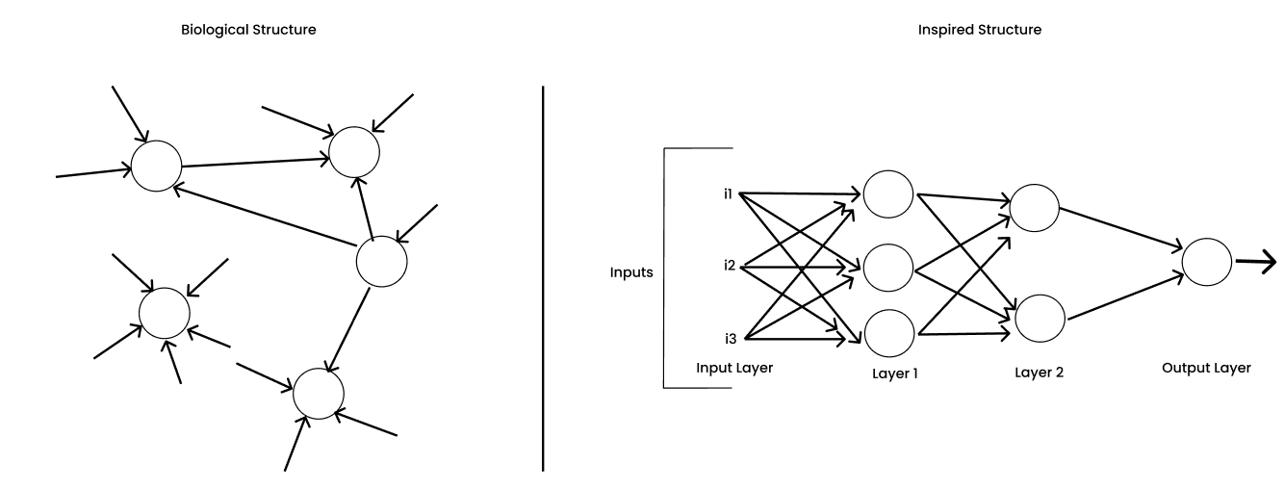
Why stop at one neuron?
Figure: Chandra Prakash Bathula, Deep Learning series, Part 1 (Towards AI)
A neuron never works alone
1969: one layer hits a wall
1986: backprop trains the layers
In the brain, every neuron sits in a dense web of connections. So researchers asked: why limit the model to one?
A single perceptron draws one straight line, so XOR is impossible. Layers can solve it, but nobody could train them.
Rumelhart, Hinton and Williams used the chain rule to send the error back through every hidden layer.
Notes:
From Part 1 of the blog series: the left side is the biological structure, the right side the network it inspired, with an input layer, two hidden layers and an output layer. That right-hand picture is exactly the shape of the MLP in Part 4.

Slide 28
What changed between 1958 and 1986
 | Perceptron (1958) | MLP + backprop (1986)
Trainable layers | One | Several, including hidden layers
Activation | Step: no useful gradient | Sigmoid: smooth and differentiable
Learning rule | Error correction on output weights only | Chain rule sends the error back to every weight
Features | Designed by hand | Learned as internal representations
XOR | Impossible | Solved
The neuron barely changed. What changed was a differentiable activation and a way to assign blame to hidden units.
Notes:
The backprop numerical example in the earlier Week 1 slides shows the chain rule step by step. ReLU replaced sigmoid much later, around 2010 to 2012.

Slide 29
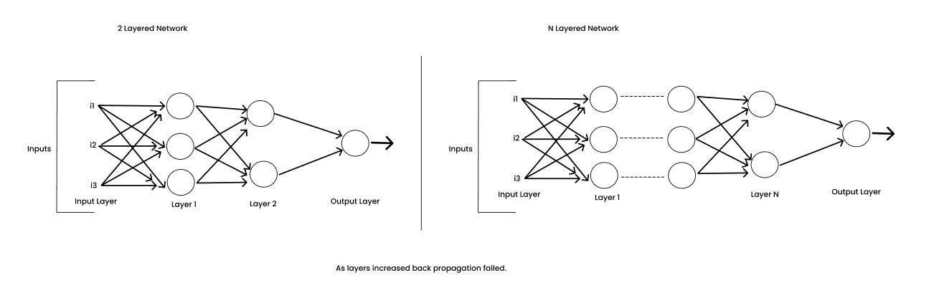
After 1986: deeper networks broke backprop, then came 2012
≈ 10⁻⁶
gradient left after 10 sigmoid layers (0.25 per layer, at best)
Figure: Chandra Prakash Bathula, Deep Learning series, Part 1 (Towards AI)
Late 1980s to 2000s
2006
2012
Second slump
Deep belief nets
The ImageNet moment
Too little data and compute. Promises outran results, and SVMs, random forests and boosted trees took over.
Hinton and colleagues train deep networks one layer at a time, laying the groundwork for modern deep learning.
AlexNet, trained on GPUs with ~1.2 million labelled images, beats every traditional vision method by a wide margin.
Notes:
From Part 1 of the blog series. Brains rely on many layers, so we want deep networks, but backprop kept failing as layers were added: the vanishing gradient. Hinton kept working on it for two decades; the 2006 deep belief net paper and the 2012 ImageNet result (data plus GPUs) brought neural networks back. Same lesson as Part 2 of today: data matters.

Slide 30
Finally, just an MLP
PART 4
Stack perceptrons, put a non-linearity in between, train with backprop
Notes:
Everything from Part 3 comes together in a model small enough to train on a laptop.

Slide 31
Two hidden units solve XOR
OR
x₁ | x₂ | h₁ (OR) | h₂ (AND) | y = XOR
0 | 0 | 0 | 0 | 0
0 | 1 | 1 | 0 | 1
1 | 0 | 1 | 0 | 1
1 | 1 | 1 | 1 | 0
x₁
h₁
y
x₂
h₂
Each hidden unit draws one straight line. The output unit combines the two lines into a region a single perceptron could never draw. These are exactly the 1958 step neurons, just stacked.
AND
h₁ = step(x₁ + x₂ − 0.5) h₂ = step(x₁ + x₂ − 1.5)
y = step(h₁ − h₂ − 0.5) "OR, but not AND"
Notes:
Check one row live with the class: x = (1,1). h1 = step(2 - 0.5) = 1, h2 = step(2 - 1.5) = 1, y = step(1 - 1 - 0.5) = step(-0.5) = 0. Correct. The hard part in 1969 was not this network, it was learning these weights automatically.

Slide 32
Today's MLP: 784 → 128 → 64 → 10
fc1
fc2
fc3
784
100,480 params
128
8,256 params
64
650 params
10
Output
Hidden 2
logits, one per digit
Hidden 1
ReLU
Input
ReLU
28 × 28 pixels, flattened
109,386 parameters in total. Softmax is applied inside CrossEntropyLoss, so the model outputs raw logits.
Notes:
Same idea as the XOR network, scaled up: two hidden layers, ReLU instead of step or sigmoid, trained with backprop and Adam. 92% of the parameters sit in the first layer because every pixel connects to every hidden unit.

Slide 33



What an MLP still cannot see
flatten
After flattening they are inputs #7 and #12: to the MLP, no closer than any other pair
5 × 5 image: the two orange pixels are neighbours
No sense of space
Shifts look like new images
Where the course goes next
Flattening throws away the 2D layout. Shuffle every image's pixels the same way and an MLP trains just as well.
A digit moved two pixels activates a different set of weights, so shift tolerance must be learned from data: one reason augmentation matters.
CNNs build spatial structure into the architecture. Later, Transformers learn which inputs to relate.
Notes:
Pixel (row 1, col 2) is index 7 and pixel (row 2, col 2) is index 12. Vertical neighbours end up five positions apart. This connects the MLP's weakness back to Part 2: augmentation supplies the invariances the architecture lacks.

Slide 34




This week's work
Data foundations
Text augmentation
Notebook: tensor creation, indexing, reshaping and arithmetic in NumPy and PyTorch.
Notebook: augment 10 sample reviews and reflect on which edits kept the label.
Image augmentation
Assignment
Notebook: CIFAR-10 originals vs augmented images, with observations.
MLP on MNIST at 5k, 10k, 30k and 50k samples, plus CIFAR-10 with and without augmentation. Plot train and test curves.
Interactive guide: open week1-site/index.html for live demos of tensors, augmentation and the MLP.
Notes:
Also this week: review the syllabus, explore the Week 1 module in Canvas, and post an introduction in the discussion forum.

Slide 35
Three ideas to take away
Learning means generalizing, not memorizing.
Augmentation creates label-preserving data almost for free.
An MLP is perceptrons + a non-linearity + backprop: 43 years in the making.
Notes:
1943 McCulloch and Pitts to 1986 backprop is 43 years. Next week builds on the MLP.

